Slide 1
Addressing the Network – IPv4
Network Fundamentals – Chapter 6

Slide 2
Objectives
Explain the structure IP addressing and demonstrate the ability to convert between 8-bit binary and decimal numbers.
Given an IPv4 address, classify by type and describe how it is used in the network.
Explain how addresses are assigned to networks by ISPs and within networks by administrators.
Determine the network portion of the host address and explain the role of the subnet mask in dividing networks.
Given IPv4 addressing information and design criteria, calculate the appropriate addressing components.
Use common testing utilities to verify and test network connectivity and operational status of the IP protocol stack on a host.

Slide 3
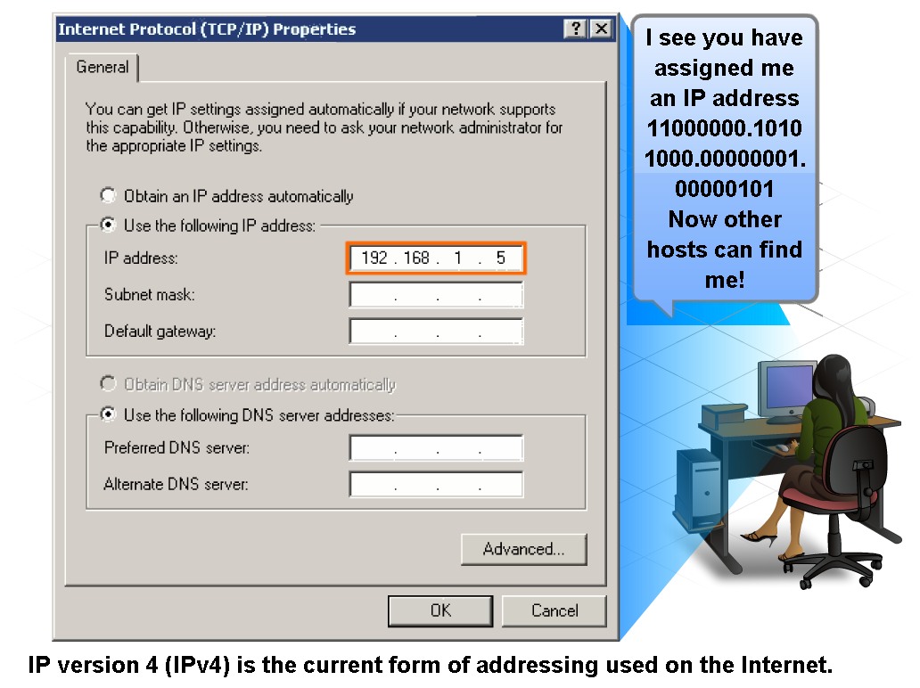
IP Addressing Structure
Describe the dotted decimal structure of a binary IP address and label its parts

Slide 4
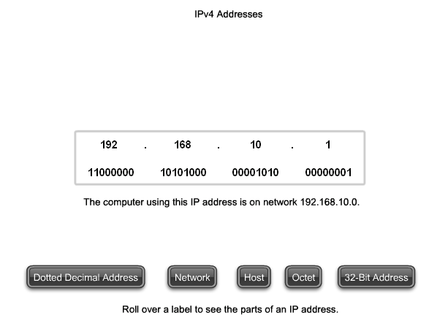
IP Addressing Structure
Describe the general role of 8-bit binary in network addressing and convert 8-bit binary to decimal

Slide 5
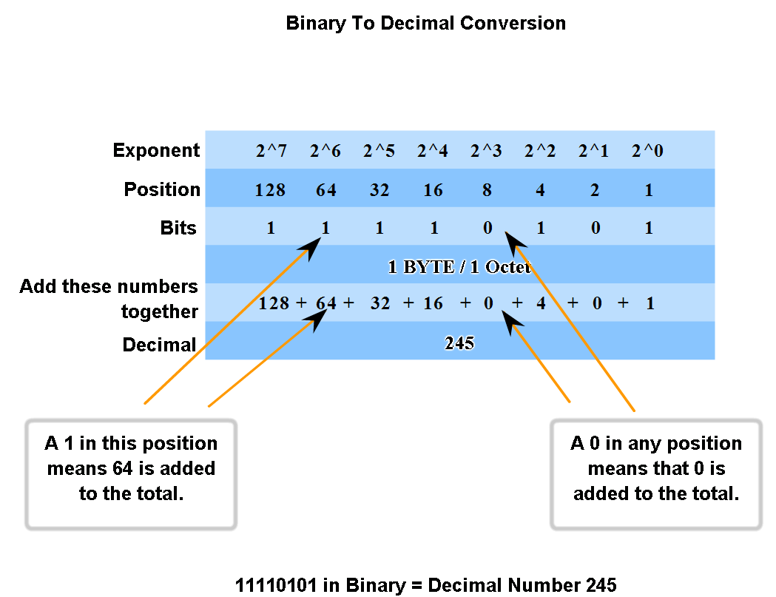
IP Addressing Structure
Practice converting 8-bit binary to decimal

Slide 6
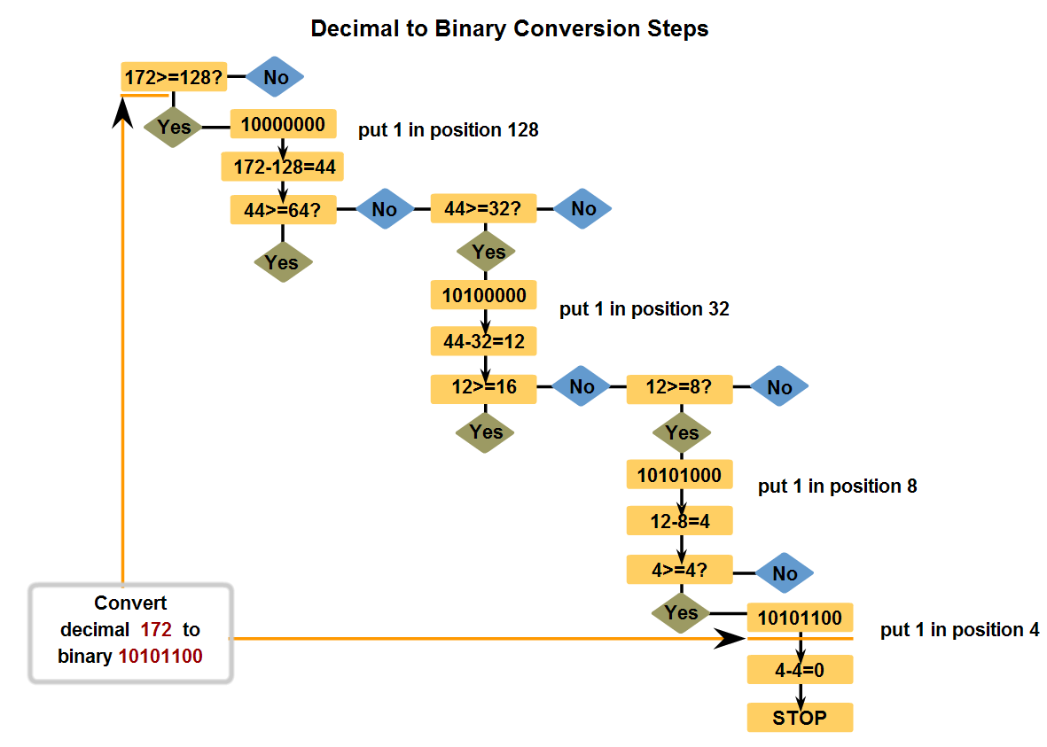
IP Addressing Structure
Convert decimal to 8-bit binary

Slide 7
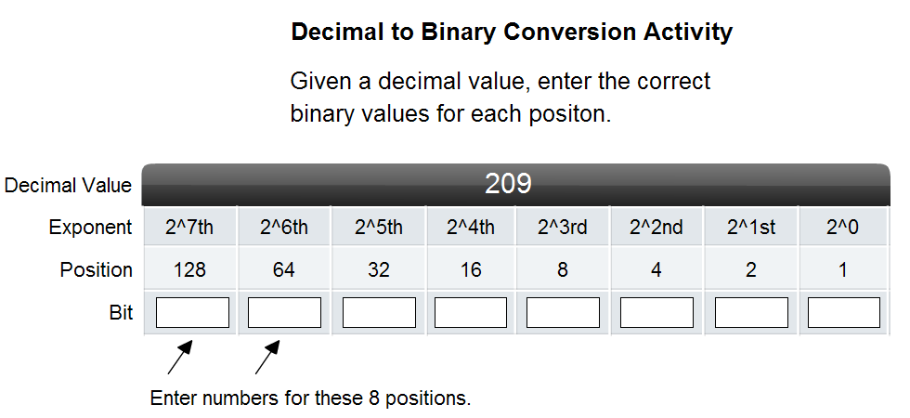
IP Addressing Structure
Practice converting decimal to 8-bit binary

Slide 8
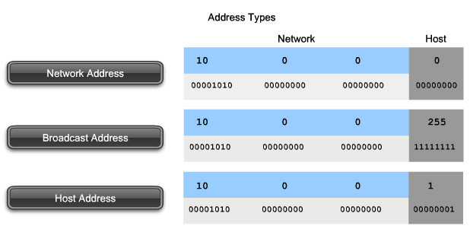
Classify and Define IPv4 Addresses
Name the three types of addresses in the network and describe the purpose of each type

Slide 9
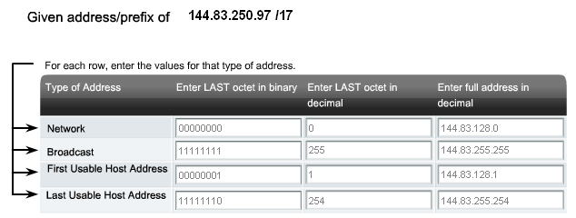
Classify and Define IPv4 Addresses
Determine the network, broadcast and host addresses for a given address and prefix combination

Slide 10
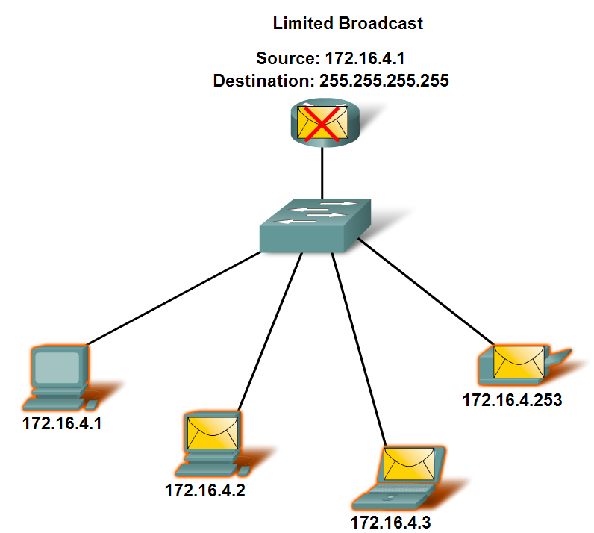
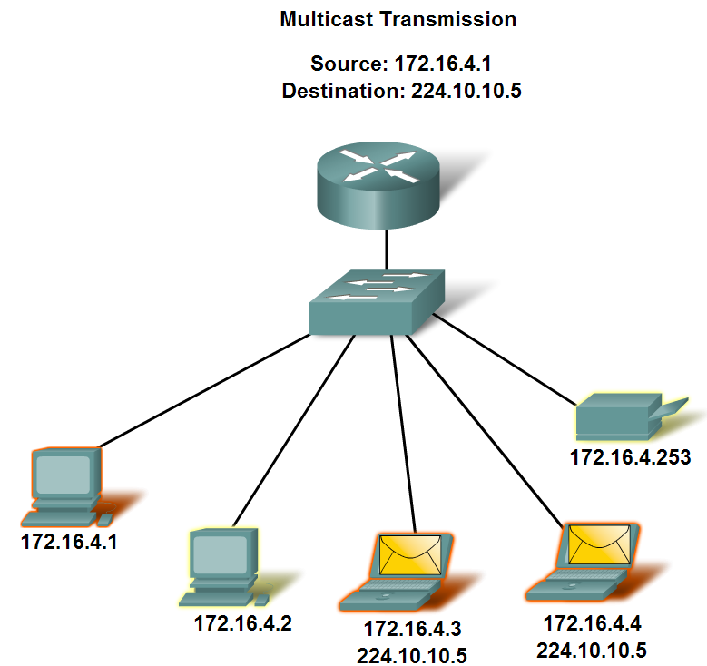
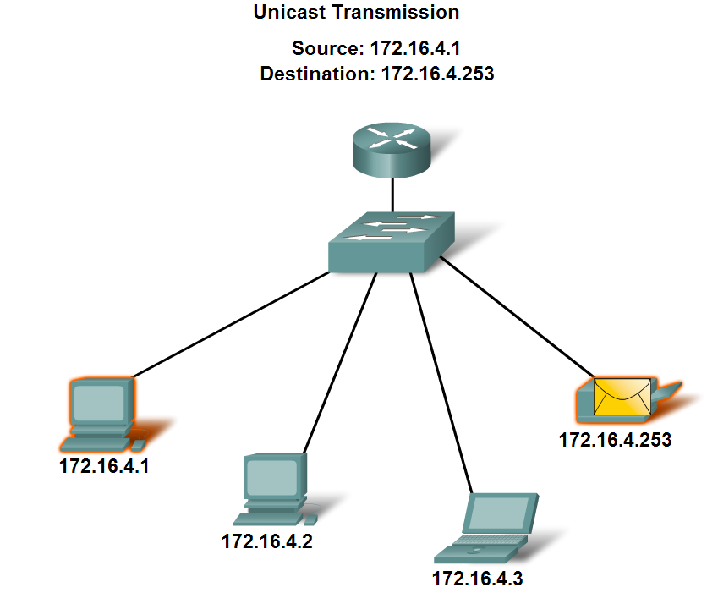
Classify and Define IPv4 Addresses
Name the three types of communication in the Network Layer and describe the characteristics of each type

Slide 11
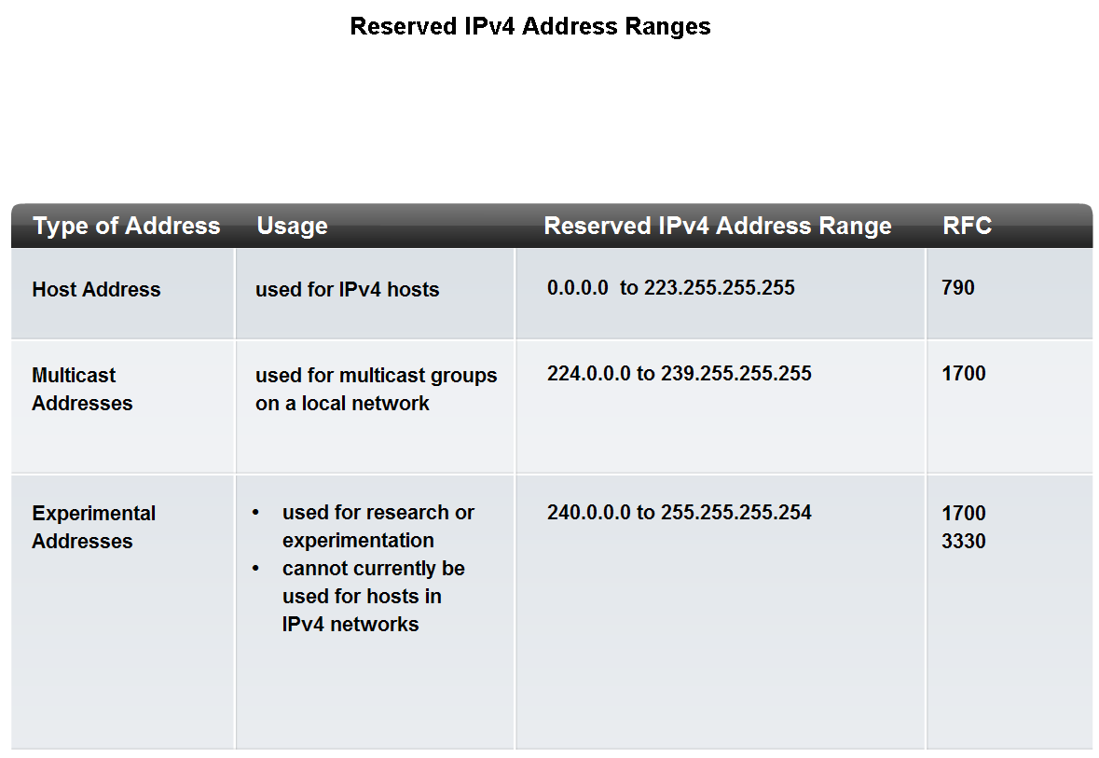
Classify and Define IPv4 Addresses
Identify the address ranges reserved for these special purposes in the IPv4 protocol

Slide 12
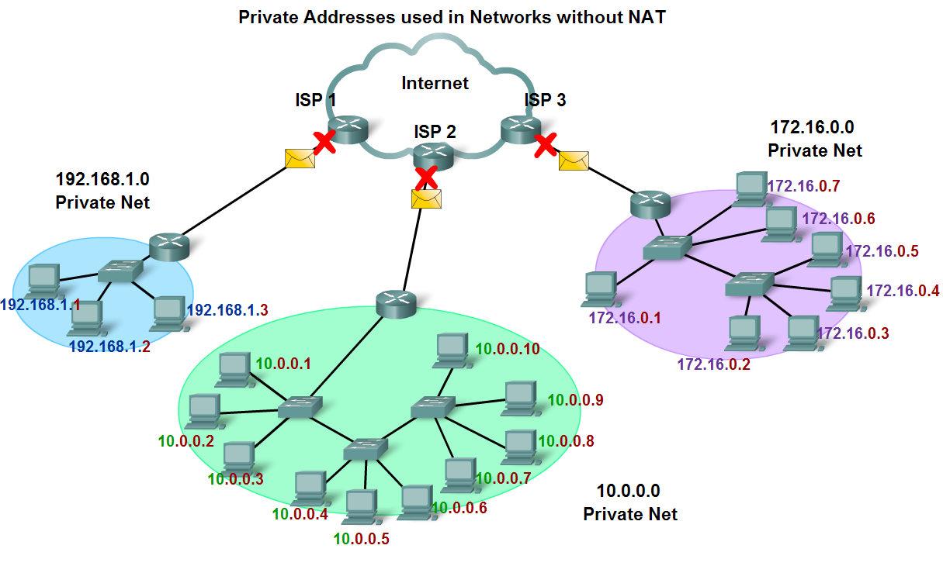
Classify and Define IPv4 Addresses
Define public address and private address

Slide 13
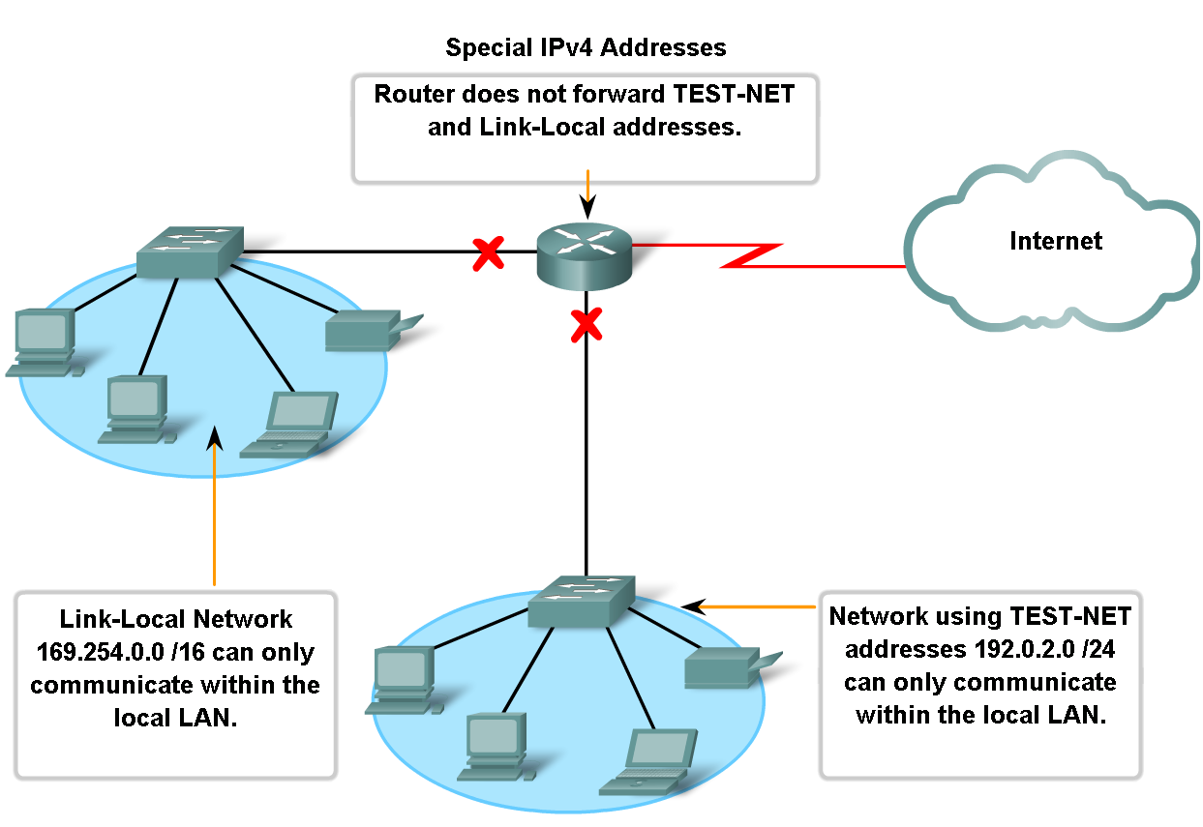
Classify and Define IPv4 Addresses
Describe the purpose of several special addresses

Slide 14
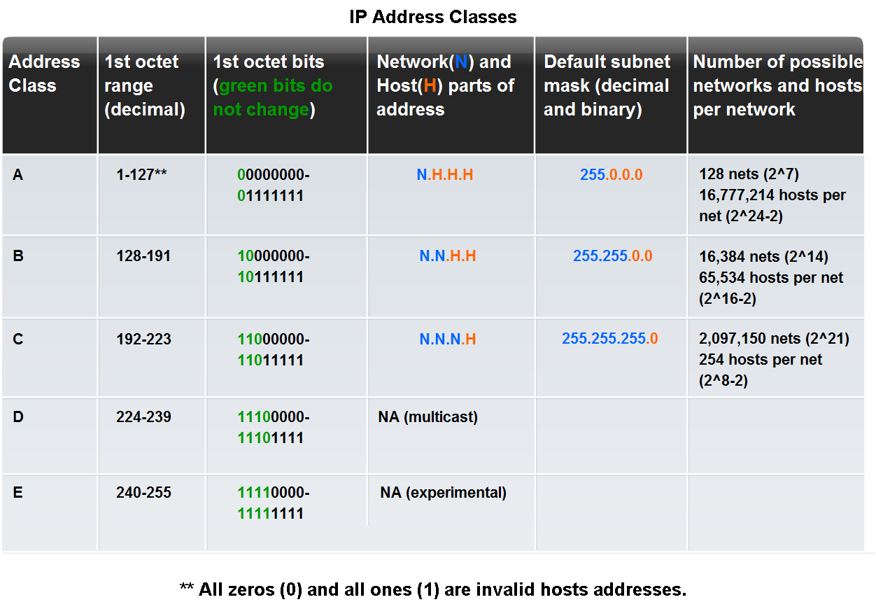
Classify and Define IPv4 Addresses
Identify the historic method for assigning addresses and the issues associated with the method

Slide 15
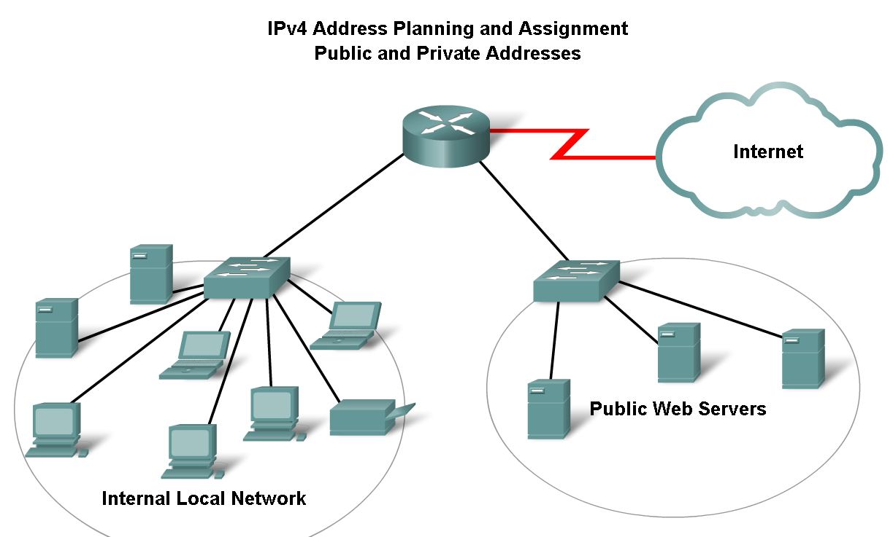
Assigning Addresses
Explain the importance of using a structured process to assign IP addresses to hosts and the implications for choosing private vs. public addresses

Slide 16
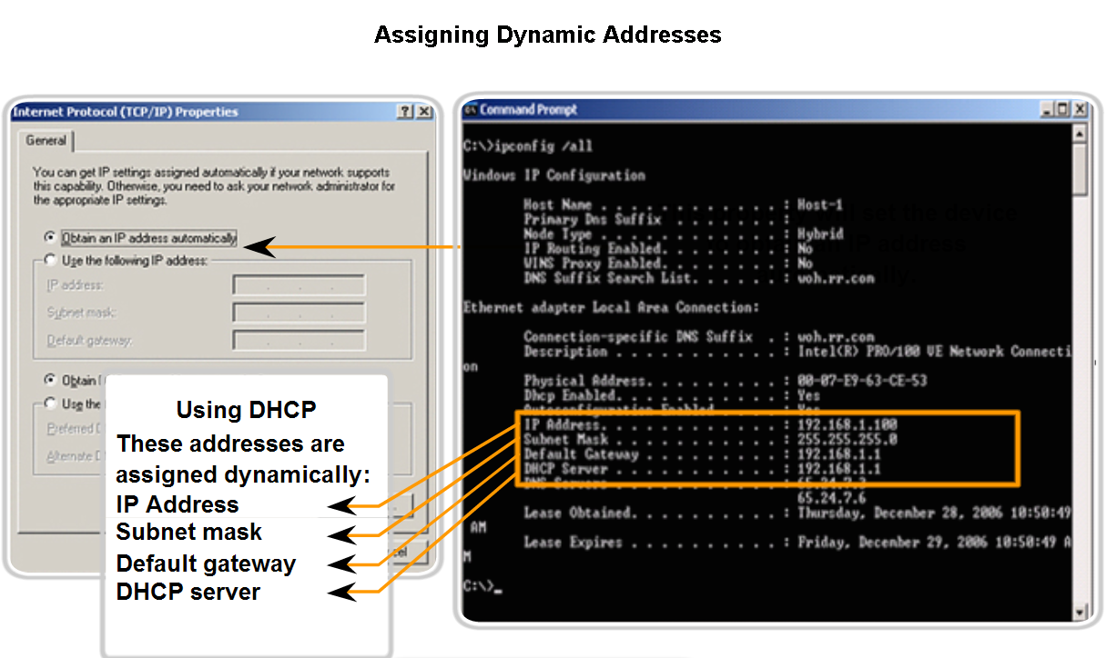
Assigning Addresses
Explain how end user devices can obtain addresses either statically through an administrator or dynamically through DHCP

Slide 17
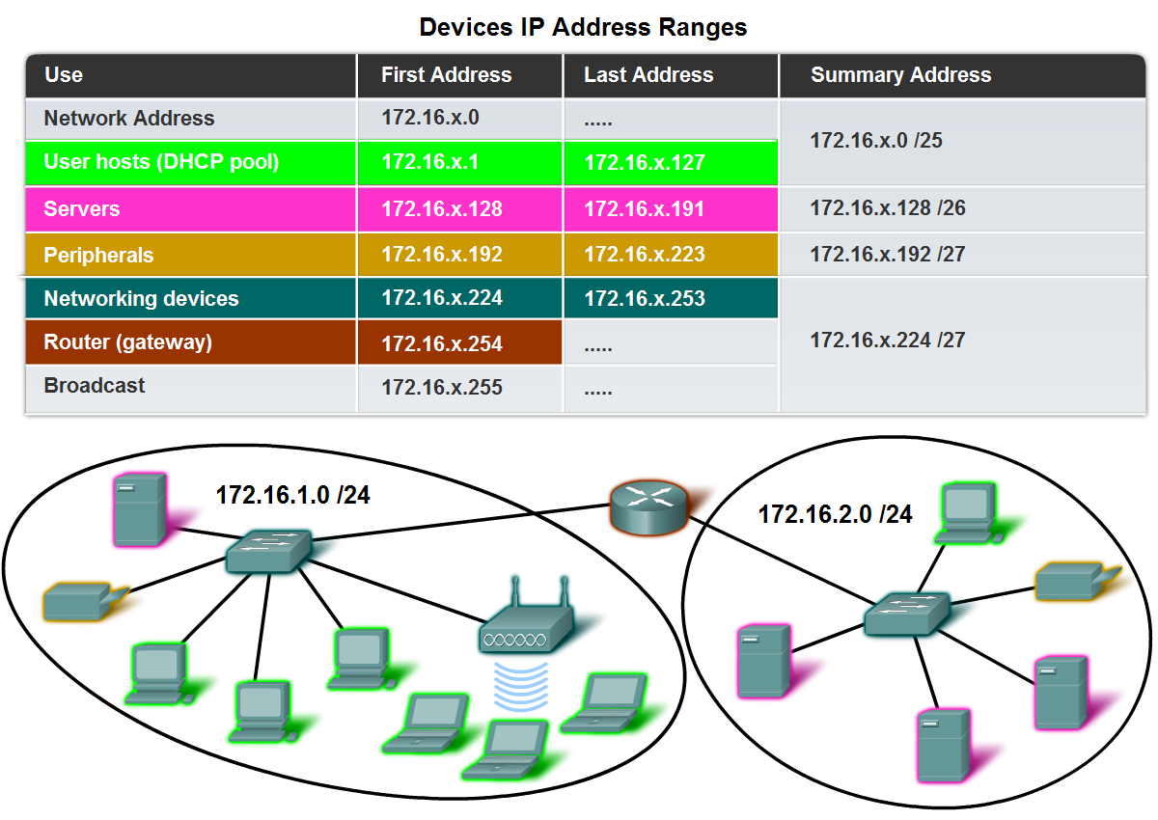
Assigning Addresses
Explain which types of addresses should be assigned to devices other than end user devices

Slide 18
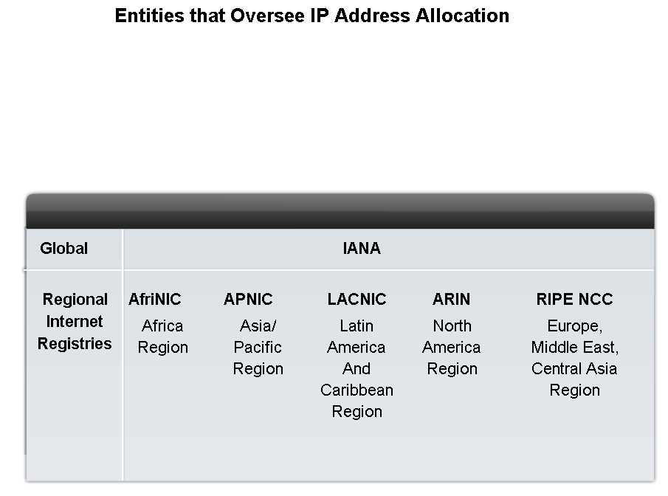
Assigning Addresses
Describe the process for requesting IPv4 public addresses, the role ISPs play in the process, and the role of the regional agencies that manage IP address registries

Slide 19
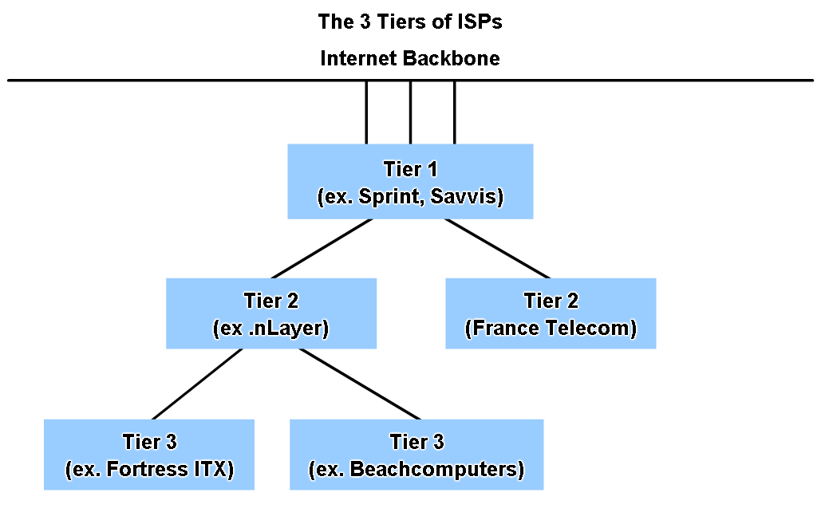
Assigning Addresses
Identify different types of ISPs and their roles in providing Internet connectivity

Slide 20
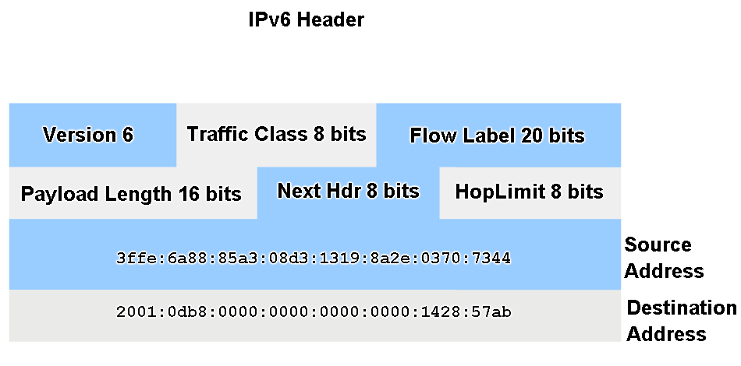
Assigning Addresses
Identify several changes made to the IP protocol in IPv6 and describe the motivation for migrating from IPv4 to IPv6

Slide 21
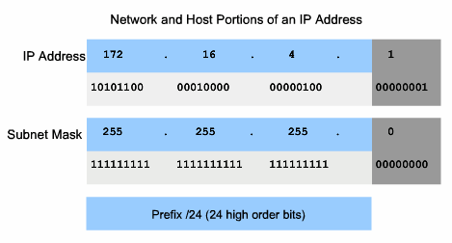
Determine the network portion of the host address and the role of the subnet mask
Describe how the subnet mask is used to create and specify the network and host portions of an IP address

Slide 22
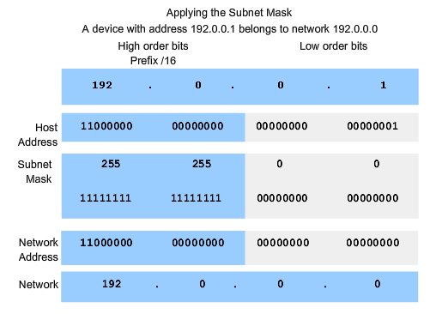
Determine the network portion of the host address and the role of the subnet mask
Use the subnet mask and ANDing process to extract the network address from the IP address

Slide 23
Determine the network portion of the host address and the role of the subnet mask
Use ANDing logic to determine an outcome

Slide 24
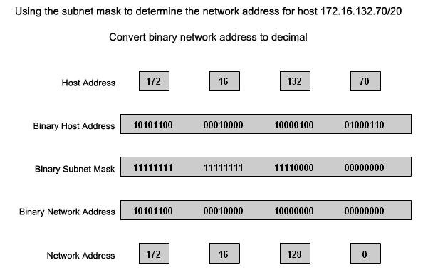
Determine the network portion of the host address and the role of the subnet mask
Observe the steps in the ANDing of an IPv4 host address and subnet mask

Slide 25
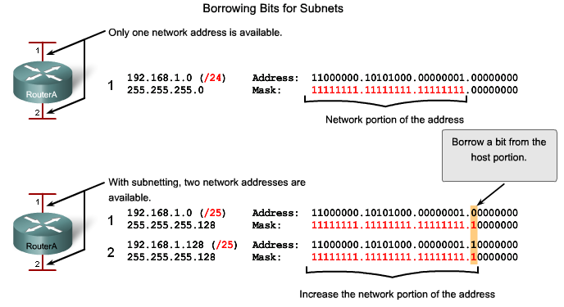
Calculating Addresses
Use the subnet mask to divide a network into smaller networks and describe the implications of dividing networks for network planners

Slide 26
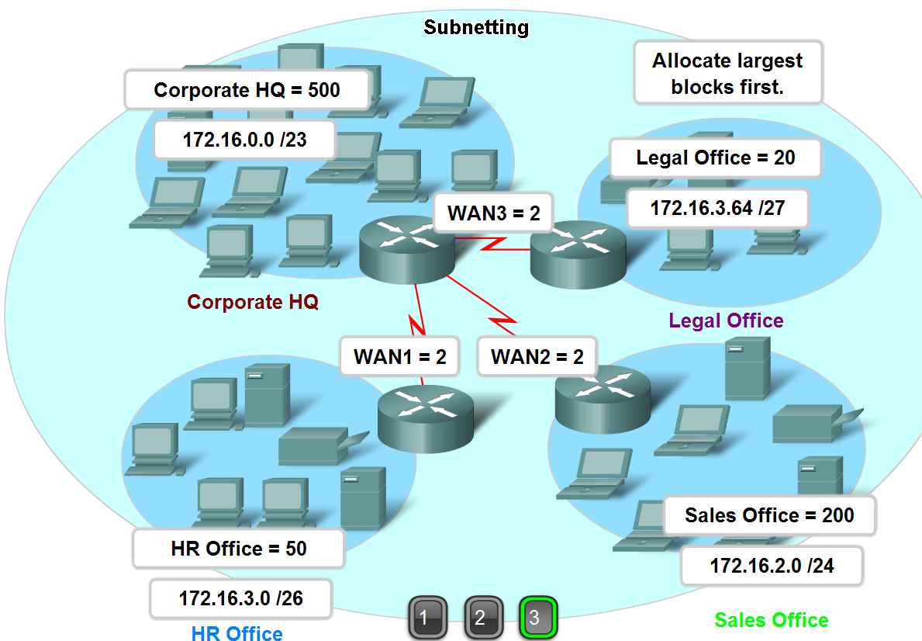
Calculating Addresses
Extract network addresses from host addresses using the subnet mask

Slide 27
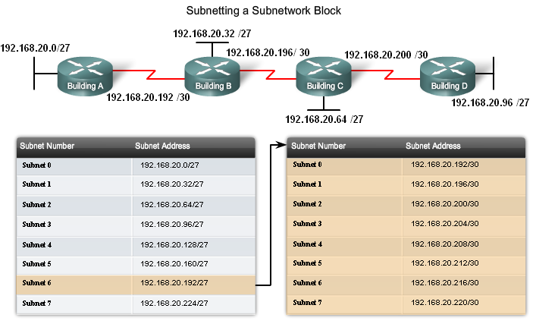
Calculating Addresses
Calculate the number of hosts in a network range given an address and subnet mask

Slide 28
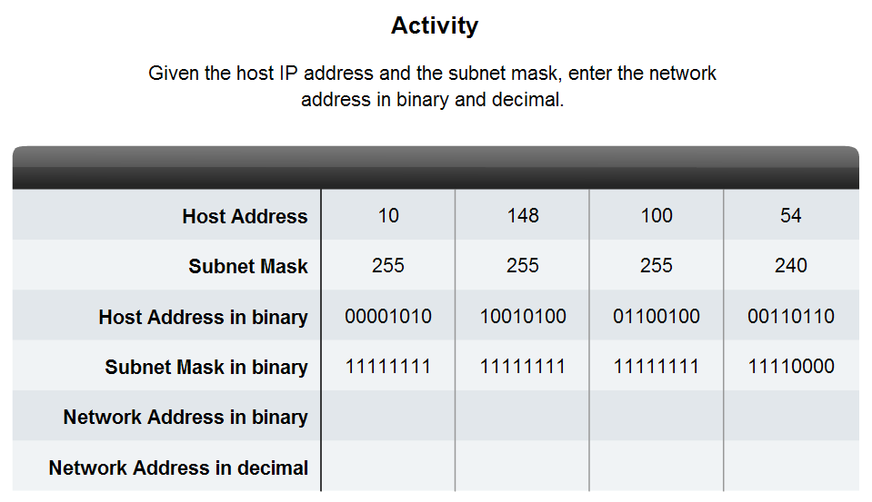
Calculating Addresses
Given a subnet address and subnet mask, calculate the network address, host addresses and broadcast address

Slide 29
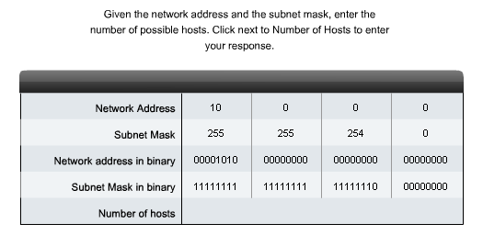
Calculating Addresses
Given a pool of addresses and masks, assign a host parameter with address, mask and gateway

Slide 30
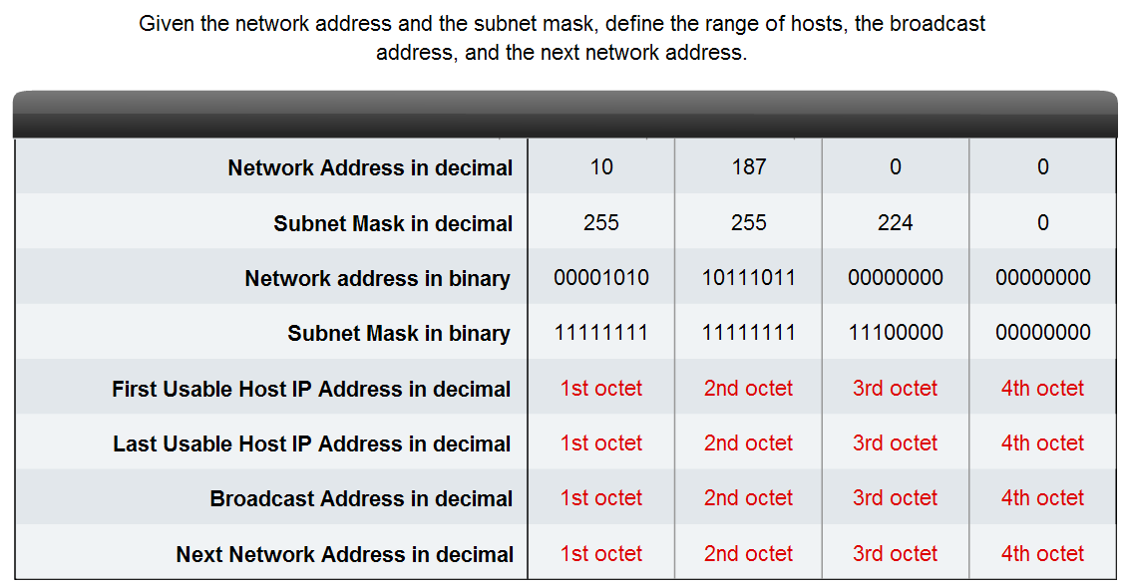
Calculating Addresses
Given a diagram of a multi-layered network, address range, number of hosts in each network and the ranges for each network, create a network scheme that assigns addressing ranges to each network

Slide 31
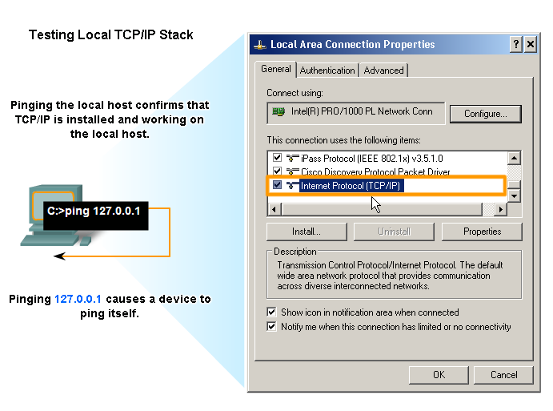
Testing the Network Layer
Describe the general purpose of the ping command, trace the steps of its operation in a network, and use the ping command to determine if the IP protocol is operational on a local host

Slide 32
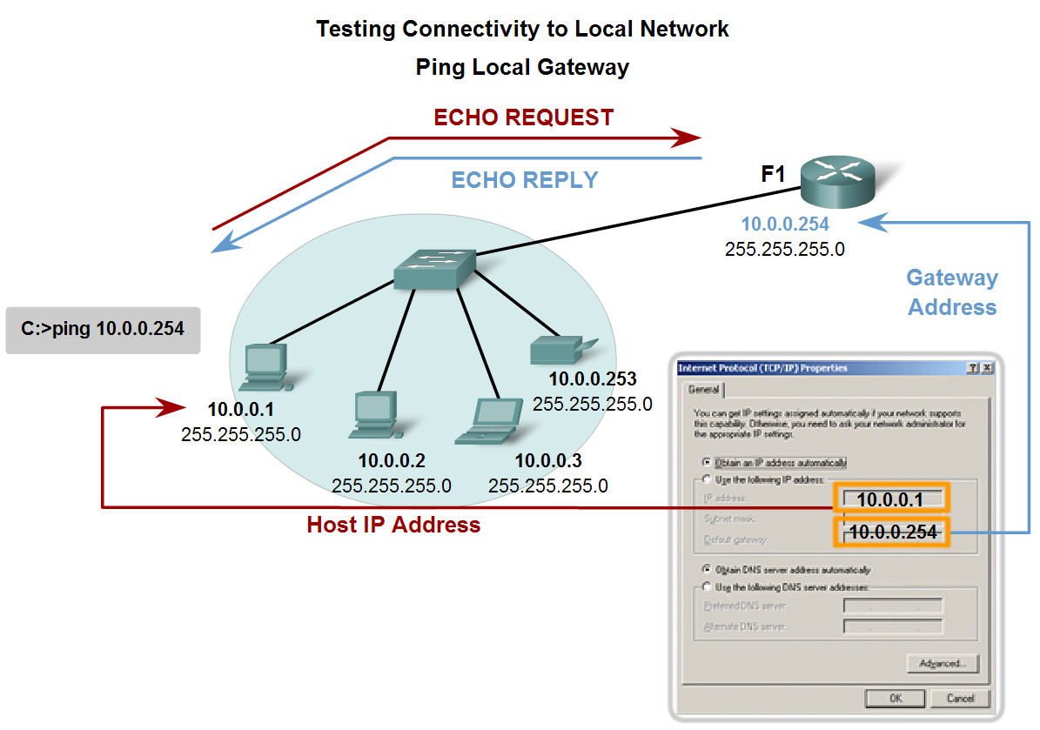
Testing the Network Layer
Use ping to verify that a local host can communicate with a gateway across a local area network

Slide 33
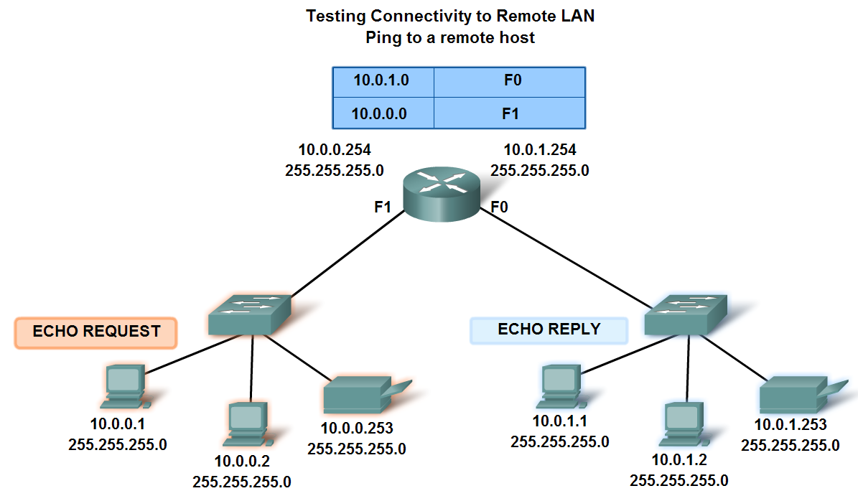
Testing the Network Layer
Use ping to verify that a local host can communicate via a gateway to a device in remote network

Slide 34
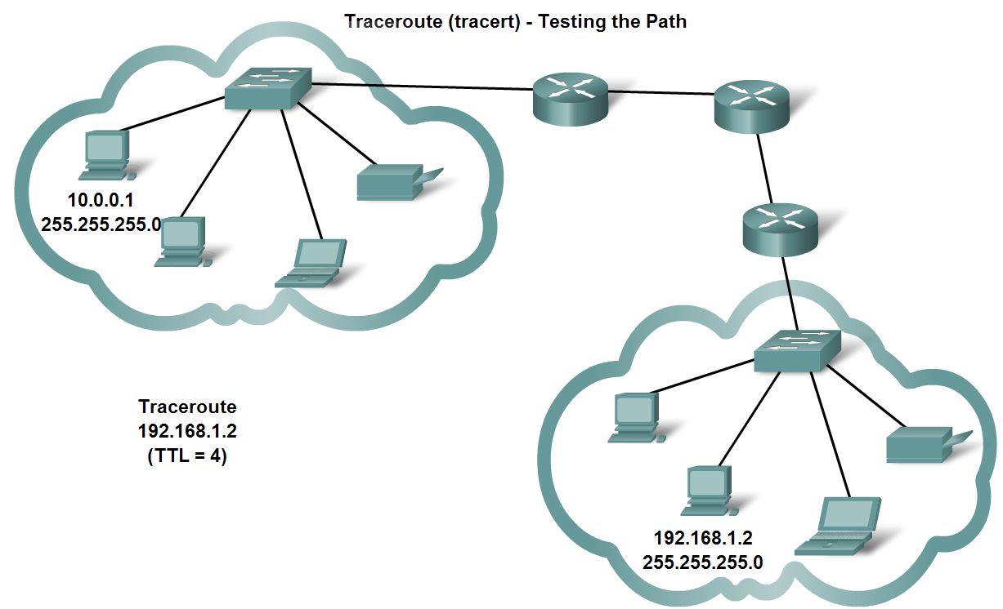
Testing the Network Layer
Use tracert/traceroute to observe the path between two devices as they communicate and trace the steps of tracert/traceroute's operation

Slide 35
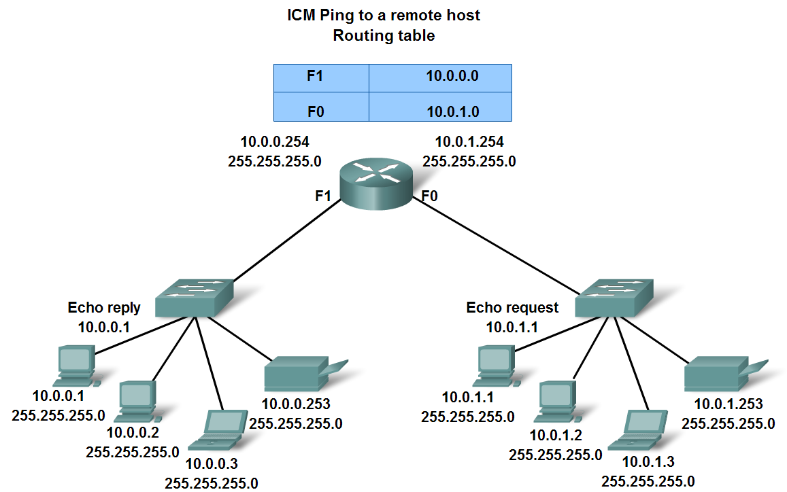
Testing the Network Layer
Describe the role of ICMP in the TCP/IP suite and its impact on the IP protocol

Slide 36
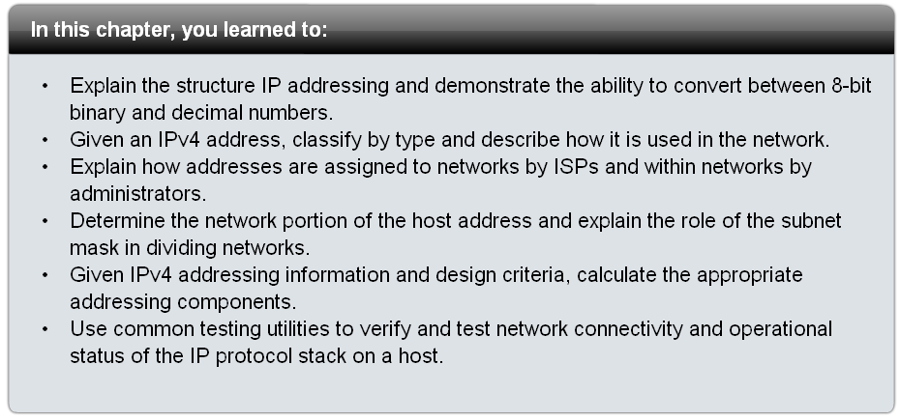
Summary

